Slide 1
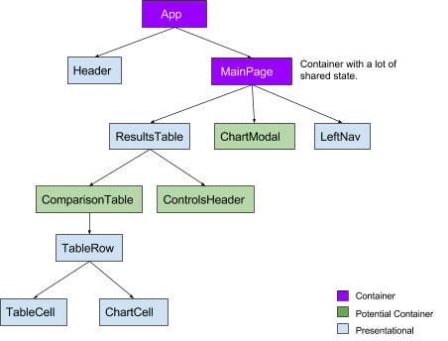
What is Recoil JS
Recoil.js is a state management library for React applications. It is designed to be simple and easy to use, while still providing the power and flexibility needed to manage complex state.

Slide 2





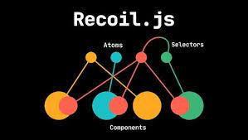
What is Recoil JS
Coinbase
Discord
Facebook
Google
Microsoft
Spotify
Stripe
Twitter / X…
Recoil.js is a state management library for React applications. It is designed to be simple and easy to use, while still providing the power and flexibility needed to manage complex state.

Slide 3
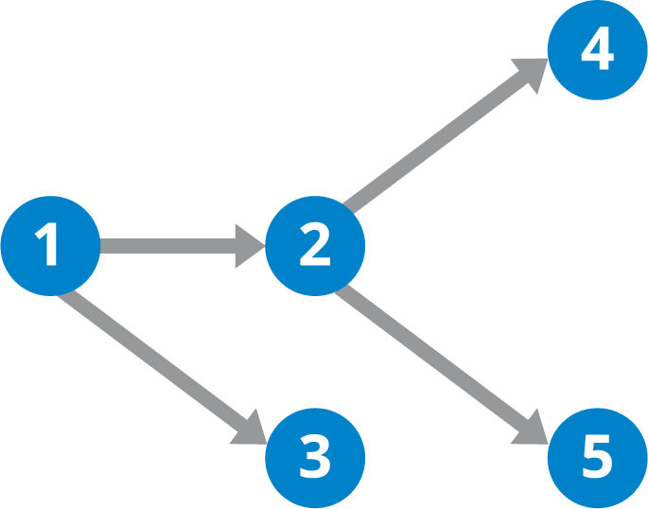
What is Recoil JS
Recoil uses a directed acyclic graph (DAG) to represent the state of an application. The nodes in the DAG represent atoms, which are the basic units of state. The edges in the DAG represent selectors, which are pure functions that transform atoms into new atoms.

Slide 4
Why learn Recoil
Using React's built-in state management capabilities is the best choice for most applications, as they are compatible and simple. However, there are some limitations:
Sharing component state requires pushing it up to the common ancestor, which can lead to unnecessary re-renders in large applications.
Context can only store a single value, which can be limiting for applications that need to manage multiple pieces of global state.
Both of these limitations can make it difficult to code-split the application.
If you are building a large or complex application, or need to overcome these limitations, then you may want to consider using an external global state management library.

Slide 5
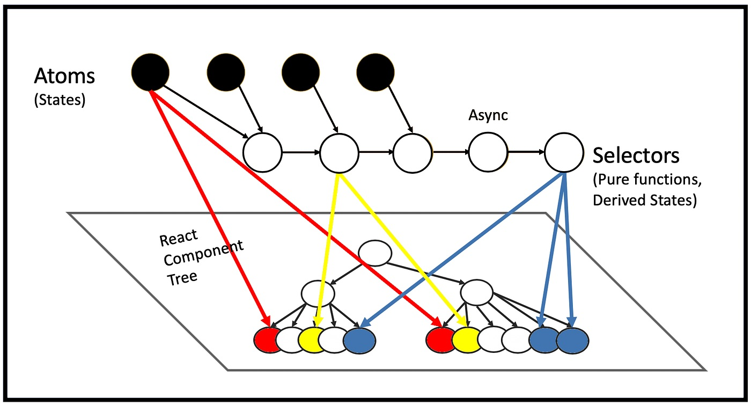
Why learn Recoil
Recoil's state management approach is orthogonal to the React tree, but also intrinsic and attached to it. This means that state changes flow from the roots of a directed graph (which Recoil calls atoms) through pure functions (which Recoil calls selectors) and into components. This approach has several advantages:

Slide 6
Why learn Recoil
Easier to develop and maintain: It is easier to develop and maintain React applications when state management is separate from the component hierarchy. This is because you can focus on developing components without having to worry about how to manage state.
More scalable: Recoil's state management system is more scalable than traditional state management approaches, such as passing props down through the component tree. This is because Recoil can efficiently update state for any part of the application, regardless of its position in the component tree.
Better support for code splitting: Recoil's state management system makes it easier to code-split React applications. This is because Recoil can efficiently manage state for any part of the application, regardless of whether it is loaded in a separate bundle.
Overall, the orthogonality of Recoil's state management system is a key advantage that makes it a good choice for developing large and complex React applications.

Slide 7
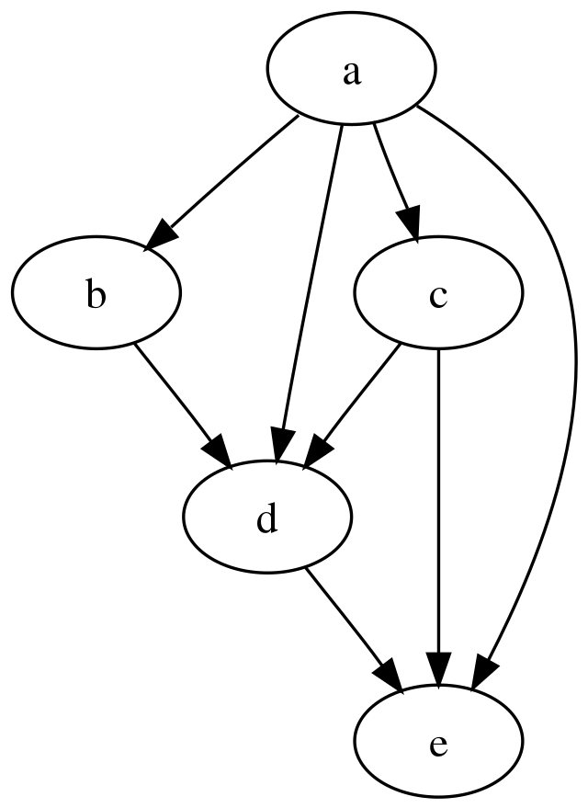
Why learn Recoil
Boilerplate-free API: Recoil provides a simple and easy-to-use API for managing shared state. This can save developers a lot of time and effort, especially when working on large and complex applications.

Slide 8
Why learn Recoil
Boilerplate-free API: Recoil provides a simple and easy-to-use API for managing shared state. This can save developers a lot of time and effort, especially when working on large and complex applications.
Same simple get/set interface as React local state: Recoil uses the same simple get/set interface as React local state. This makes it easy for developers to learn and use Recoil, even if they are not familiar with state management libraries.

Slide 9
Why learn Recoil
Boilerplate-free API: Recoil provides a simple and easy-to-use API for managing shared state. This can save developers a lot of time and effort, especially when working on large and complex applications.
Same simple get/set interface as React local state: Recoil uses the same simple get/set interface as React local state. This makes it easy for developers to learn and use Recoil, even if they are not familiar with state management libraries.
Can be encapsulated with reducers if needed: Recoil supports the use of reducers to encapsulate state changes. This can be useful for complex state management scenarios.

Slide 10
Why learn Recoil
Boilerplate-free API: Recoil provides a simple and easy-to-use API for managing shared state. This can save developers a lot of time and effort, especially when working on large and complex applications.
Same simple get/set interface as React local state: Recoil uses the same simple get/set interface as React local state. This makes it easy for developers to learn and use Recoil, even if they are not familiar with state management libraries.
Can be encapsulated with reducers if needed: Recoil supports the use of reducers to encapsulate state changes. This can be useful for complex state management scenarios.
Compatible with Concurrent Mode and other new React features: Recoil is compatible with Concurrent Mode and other new React features. This means that developers can use Recoil to take advantage of the latest performance improvements in React.
Supports incremental state definition: Recoil supports incremental state definition. This makes it easy to add new state to an application over time.
Supports code splitting: Recoil supports code splitting. This means that developers can split their applications into multiple bundles, which can improve loading times.
Supports derived data: Recoil supports derived data. This means that developers can create new state values that are based on existing state values.
Treat navigation as a first-class concept: Recoil makes it easy to treat navigation as a first-class concept. This means that developers can use Recoil to manage the state of their application's navigation system.
Persist the entire application state in a backwards-compatible way: Recoil makes it easy to persist the entire application state in a backwards-compatible way. This means that users' state will not be lost if the application is updated.

Slide 11
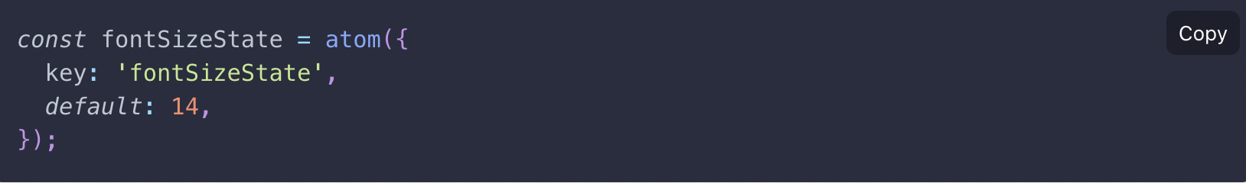
What is an Atom
Atoms are units of state in Recoil. They're updatable, subscribable, and can be created at runtime.
Atoms can be used in place of React local component state, and all components that share the same atom share its state.
All components that share the same atom share its state. When multiple components use the same atom, they all share the same state. This makes it easy to keep multiple components in sync with each other.
Overall, atoms are a powerful and flexible way to manage state in React applications. They are easy to use and offer a number of advantages over other state management solutions

Slide 12
What is an Atom
Atoms need a unique key, which is used for debugging, persistence, and for certain advanced APIs that let you see a map of all atoms. It is an error for two atoms to have the same key, so make sure they're globally unique. Like React component state, they also have a default value.
Overall, atoms are a powerful and flexible way to manage state in React applications. They are easy to use and offer a number of advantages over other state management solutions

Slide 13
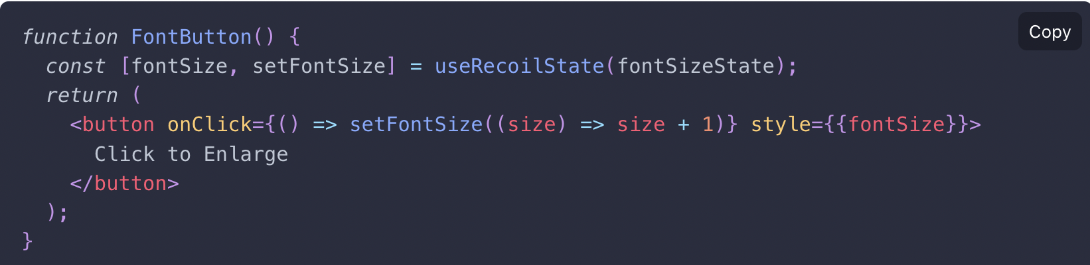
What is an Atom
To read and write an atom from a component, we use a hook called useRecoilState. It's just like React's useState, but now the state can be shared between components:

Slide 14
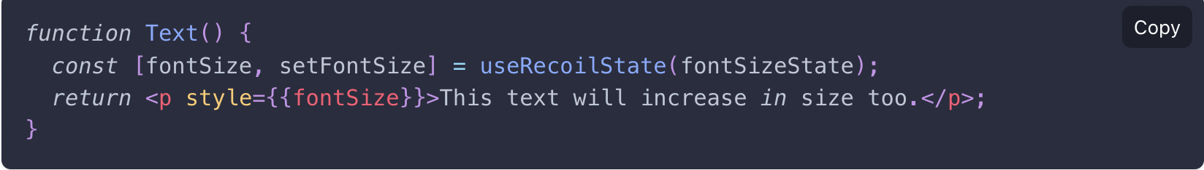
What is an Atom
Clicking on the button will increase the font size of the button by one. But now some other component can also use the same font size:

Slide 15
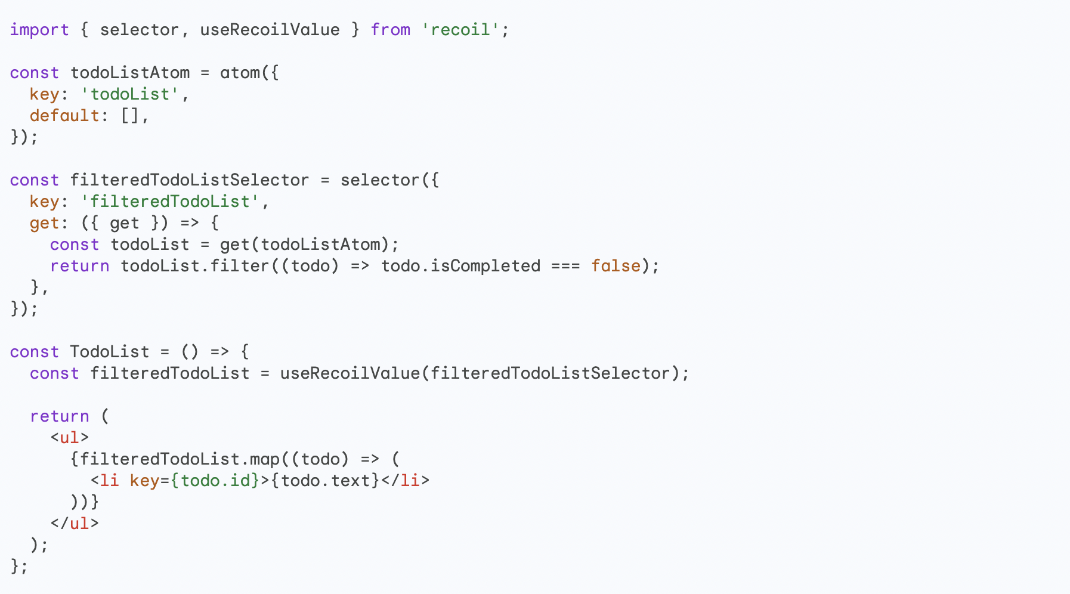
What is a Selector
Selectors in Recoil are pure functions that transform atoms into new atoms. They are used to create derived data, such as a filtered to-do list or a total price.
Selectors can be used to simplify your code and make it more efficient. For example, instead of writing a function to filter a to-do list every time you need to display it, you can create a selector that does the filtering for you. Then, you can simply subscribe to the selector in your component and it will be re-rendered whenever the filtered to-do list changes.

Slide 16
What is a Selector
Selectors in Recoil are pure functions that transform atoms into new atoms. They are used to create derived data, such as a filtered to-do list or a total price.

Slide 17
What is a Selector
There are a few advantages to writing the filter code as a selector instead of a filter helper function:
Selectors are pure functions. This means that they do not have any side effects, such as modifying the state of the application. This makes selectors easier to reason about and test.

Slide 18
What is a Selector
There are a few advantages to writing the filter code as a selector instead of a filter helper function:
Selectors are pure functions. This means that they do not have any side effects, such as modifying the state of the application. This makes selectors easier to reason about and test.
Selectors can be shared between components. This means that multiple components can subscribe to the same selector and be re-rendered whenever the selector changes. This can save developers from having to write the same filter code multiple times.

Slide 19
What is a Selector
There are a few advantages to writing the filter code as a selector instead of a filter helper function:
Selectors are pure functions. This means that they do not have any side effects, such as modifying the state of the application. This makes selectors easier to reason about and test.
Selectors can be shared between components. This means that multiple components can subscribe to the same selector and be re-rendered whenever the selector changes. This can save developers from having to write the same filter code multiple times.
Selectors can be memoized. This means that the result of a selector is cached and only re-evaluated when the inputs to the selector change. This can improve the performance of applications by avoiding unnecessary recalculations.

Slide 20
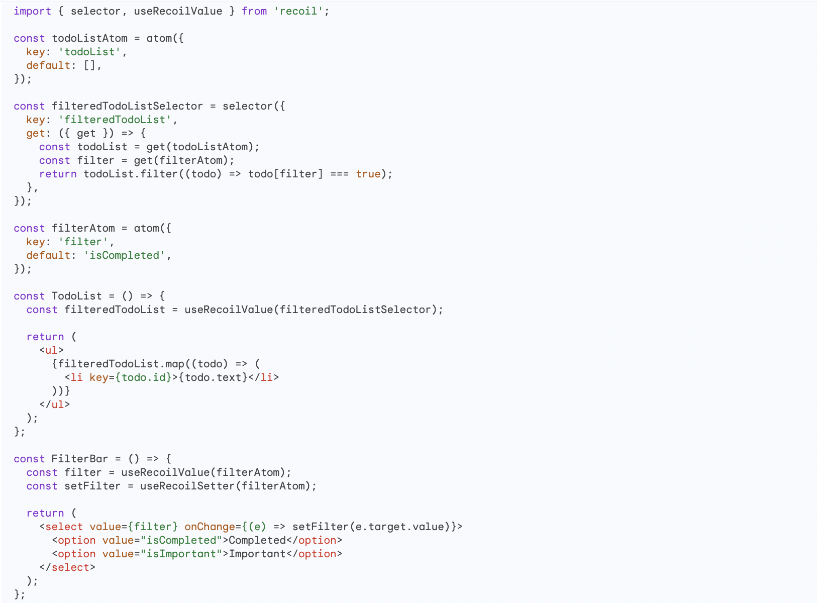
What is a Selector
Here is an example of how to use a selector to maintain a globally accessible state of changed filtering data:

